Slide 1
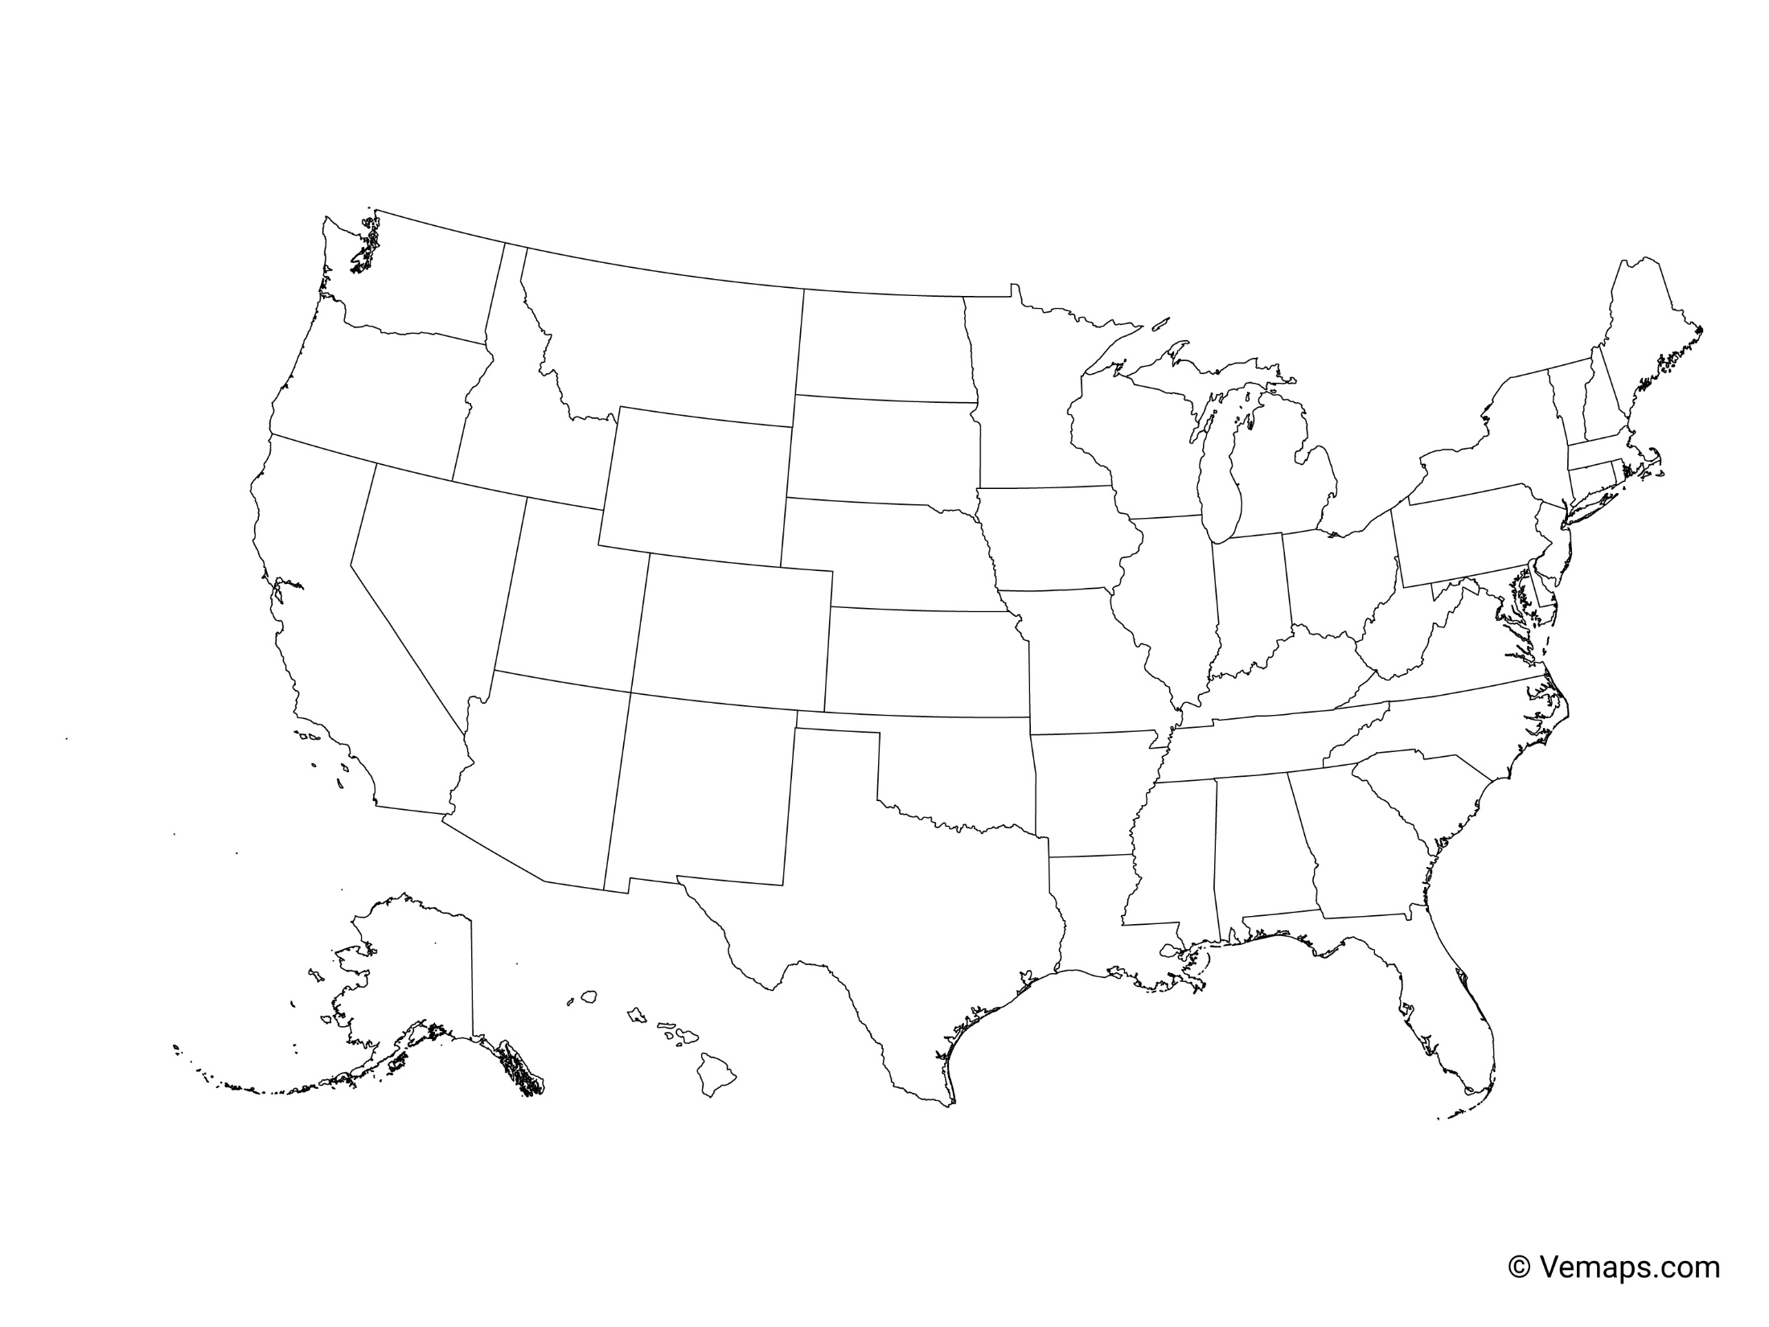
State-istical Insights: A Comparative Analysis
Charlonda Bledsoe

Slide 2


Overview
State Comparison Analysis: Select two states to analyze and compare the available metrics about that state. Delve into a more detailed analysis using the provided tables.
Greg Walker
Indiana: Population 6.833 Million
Tennessee: Population 7.051 Million
Notes:
IN and TN both contribute to Progressive’s CL auto segment. Together, these two states make up small portion of Progressive’s business with a combined policy count just under 600k policies for the year 2022, but it doesn’t make them any less important.
I chose these two states as they have similar population sizes (read above). Also, I’m from Indiana! The data in this presentation will be from the year 2022.
We’re going to dive into a couple of categories and help you to get to know these two states a little bit better.

Slide 3


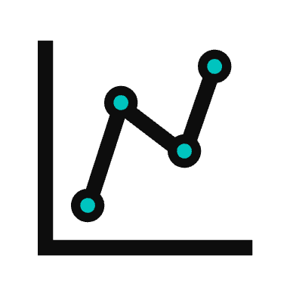
TOPICS
Policies In Force
Earned Premium
Business Market Analysis
Notes:
Topics
Policies In Force
Earned Premium
Market Analysis

Slide 4
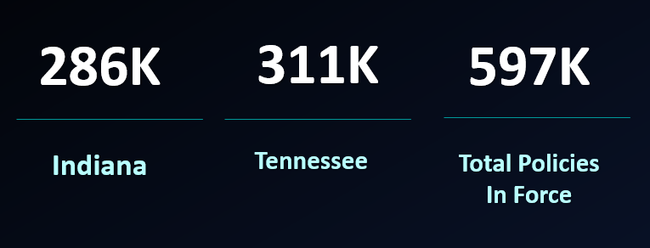
2022 Policies In Force
PIF Comparison By Quarter
Notes:
I broke down policies in force by quarter. We’ll go into some more detail on the next page, but a general overview will show us that of the 597,291 policies, TN has more PIF with 52% of that total, coming in at 311,346 policies and Indiana trailing behind with 285,945 policies or 48% of the total policies in force.
Do note though that we can see a steady incline with IN while TN looks to stop growing between Q3 and Q4

Slide 5
2022 Policies in Force
Trendline
Notes:
What you will see from the two charts on the left is an upward trend of policies in force coming into Progressive in 2022.
Again, you will see IN had a steadier incline while TN slowed down a lot between Q3 and Q4 adding only 38 policies.
I did look at growth percentage as well. Both states saw a decrease in growth rate. So, while we did add policies, the rate of growth at which we were adding the policies slowed down quite a bit.
IN had a -2.35% growth rate from Q2 to Q4 while TN had a bigger decline in growth rate of -3.41% during that same time.
There was a 2022 CL Planning Meeting that addressed ways to grow business with plans as far out as 2026. This included technology, hiring more people, and more multi-product offerings.
* https://progressiveinsurance.sharepoint.com/:p:/r/sites/PCA%20Marketing%20-%20Process%20and%20Projects%20Collaboration/_layouts/15/Doc.aspx?sourcedoc=%7BEB4B6716-5FF4-452B-AE83-49F0018E6B1C%7D&file=2022%20CL%20Planning%20Meeting%20Summary%20PM%20mtg%20v2.pptx&action=edit&mobileredirect=true&DefaultItemOpen=1
** https://progressiveinsurance.sharepoint.com/sites/highway/Pages/tricia-in-office-07.aspx?ref=email

Slide 6
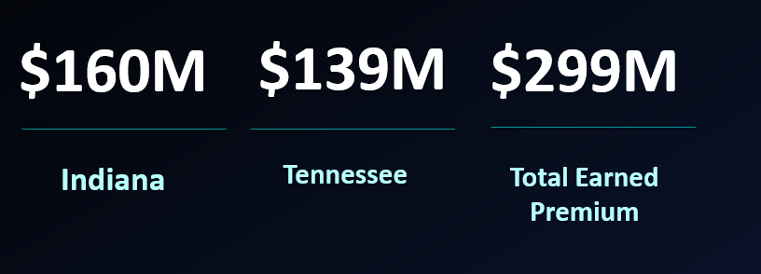

2022 Earned Premium
Earned Premium Comparison
By Quarter
Earned Premium
Quarters | IN | TN
Q1 | $ 38,045,488 | $ 33,555,292
Q2 | $ 40,618,380 | $ 35,433,317
Q3 | $ 40,855,388 | $ 35,259,582
Q4 | $ 40,590,945 | $ 34,955,440
Notes:
Next, we’re going to talk about earned premium. Indiana brought in about 160M and TN brought in about 139M for a total of about 299M. What we can see here compared to the last charts is that while TN has more policies in force, Indiana pulls in more premium on their policies. In both cases, premium went up in Q2, but then very slowly declined as the year went on. In the chart just above, and the column chart to the right, you can see just how slowly premium went down.
There are a few potential reasons for negative earned premium.
The insurer writing fewer policies which we did see from our policies in force with TN
We also had the pause in 2022
Customers are reducing their coverage amounts on renewals.
Policies are being cancelled mid-term, reducing the earned premium.

Slide 7
2022 Earned Premium and Growth Rate By Month
Moving Average
Moving Average
Notes:
One other thing I did was look at earned premium by month and found some interesting information.
I did go ahead and add in the moving average to smooth out the fluctuations and highlight the longer-term trend cycle for earned premium by month
From the charts– what you can see is a consistent up and down trend with a spike every 3 months.
With the spikes, I recalled one of our first trainings we did where the 5 - week months (January – April – July – October) showed higher pay out on claims if I remember correctly. I looked up the 5 weeks months showing for 2022 and found that the months aligned. So, we can see every quarter a spike in premium because we have an extra month to play with. This was cool to figure out! I’m not sure if it would work, but it could be an interesting concept to report out every 4 weeks v every month, but then again that’s what the moving average helps with.

Slide 8
2022 Policies In Force & Earned
Premium Analysis
Notes:
Finally, I wanted to see the PIF and EP combined for both states. Are they moving at the same rate?
Indiana’s PIF and premium for the most part grew at the same rate, but with a small decline in premium as we went into quarter 4.
Tennessee had the growth in policies, but their earned premium did not grow with those policies

Slide 9
Business Market Analysis
5
BMT
SUB BMT
DESCRIPTIONS (TYPE)
21
134
Notes:
So now we’re going to look at the types of policies and how much they contributed to our policies in force and earned premium
We’re going to look at the most popular types

Slide 10

100,188
176K
$191M
102,030
Notes:
What we see here is that, While Indiana writes more policies in the For Hire Transport Market TN writes more policies in the Business Auto Market. What’s interesting though is that both IN and TN have more premium from the For Hire Transport Market with a combined total of about $191M in EP.
Just by looking at these charts, With TN already writing more policies in force, I would recommend they find a way to increase their addressable market in the For Hire Transport area. Indiana should focus on finding ways to continue to build and expand this market.
Because both states earn more it the for hire transport Market, we’re going to take a further look here. Combined the for Hire Transport Market has about 176K Policies in Force

Slide 11
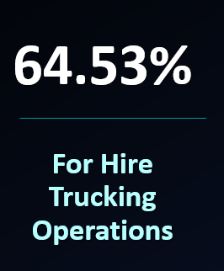
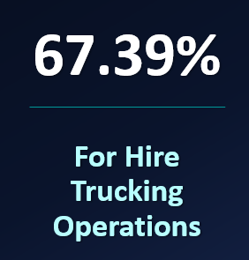
Combined
Agricultural Hauling
Auto Haulers
Escort Vehicles
Expediters
Freight Forwarders
Hazardous Materials
Household Movers
Livestock Hauling
Machinery & Heavy Equipment
Mobile Home Toters
Refrigerated Goods
Steel Hauling
113K
129M
Rounded to the nearest million
Notes:
There is only one Submarket for the For Hire Transport and that is FHT (For Hire Transport)
Under FHT There are 11 description types.
You will see that the For Hire Trucking Operations type has the most PIF and Earned premium compared to the remaining 10 categories combined. 64.53% of PIF (about 113K policies) and 67.39% ( about129M) on the earned premium between IN and TN.
As I did research on the market and type, I had this wow moment! My husband is an operations manager for a moving company. As soon as I saw the For Hire Transport and For Hire Trucking, I immediately called and asked is his company considered a for hire transport company – and yes, they are. So obviously I ask do you all carry your insurance with Progressive? He let me know that because they are so high risk how they operate with potential losses that their company as well as other companies like theirs, pay into a place called Captive Resources where they are owners of their own insurance rather than buyers of insurance policies.
Because Progressive is already capturing so much of this business, I think there is opportunity to market themselves to these types of companies and maybe gain more customers.

Slide 12
Summary
Tennessee : More Policies in Force
Indiana: More Premium
For Hire Transport Market
For Hire Trucking Operations
Notes:
Summary: Progressive had about 16 million policies in force in 2022. IN and TN had 600K policies in force, we have room to expand in those states. Through examining the data, we saw that TN had more policies in force, and Indiana had more earned premium. And we saw that both states do well in the for-hire transport market specifically with the for-hire trucking operations type.
There are opportunities to reach different market types in both states, but continuing to analyze and understand these states can help leaders make better decisions to grow CL business for Progressive.

Slide 13

Notes:
And one final pie chart for Aleks lol

Slide 14


Aleks Jovanovich
Lisa Dunnigan
Courtney Smith
Janet Czapor
ADP
Greg Walker
Ava Ryan
Anes Slijvo
Britt Shute - Orcutt
Chris Kimsey
Erik Jones
Esequiel Caraballo
Gen2
ACE Licensing
Erica Dunk
Nicholas Tanko
Bridget Resnik
Marissa Mondrut
Tara Delozier
Pam Aycock
Rae Yeshe
Kelly Kucinski
Marie Wood
Sue Franke
Lou Holmes
Florence Chadwick
Lisa Jabar
David James Miller
Kat Pinkney
Charles Battles
Ivy Chow
Smita More
Ruth Cate
April Smith
Rowan Wehrmann
Jalen Guzman
Anthony Lewis
Cindy Sapochetti
Ryan West
Matthew Brigham
Tim Cenna
Nicholas Rueter
Adam Allen
Nadia Firdman
Dale Deering
Elias Chbeir
Isamar Gonzalez Torres
Derek Fazulak
Trevor Harkreader
Danny Reyes
Kaleaf James
Xavier Zup
Austin Cade
Matt Lavigne
Erica Farmer
Steve Spence
Tim Fields
Sravanthi Villampati
Erin Jackson
Jenn Jacobs
Cody Bookner
Christina Dixon
Luke Milligan
Rick Schulte
Jonathan Bruno
Martha Stafford
Gadi Simchon
Karen Jensen
Andres Troya
Leslie McAllister
Natalie Semon
Jess Bertram
Bailey Ladner
Tammy Krestel
Casey Ocasio
Stephanie Lentz
For I know the plans I have for you declares the Lord. Plans to prosper you and not to harm you. Plans to give you hope and a future. Jeremiah 29:11
Love you Joe, Devin, Olivia, & Noah
Thank you

